Slide 1

Names, Binding and Scopes
Sabrina Tarin Chowdhury

Slide 2
Names
Variables have names!
A string of characters used to identify some part of a program
So do procedures, parameters, etc.
A name can also represent an abstraction of a complicated program fragment (e.g., class (data abstraction), module).
Earliest languages used single character var names (math-based)
Fortran-I changed this, allowing up to six characters

Slide 3
Name Forms
In most languages: letter followed by letters/digits/underscore
Older languages my_stack, newer languages myStack
PHP: begin with $
Perl: $ @ % based on specifies type
Ruby: @ instance variable, @@ class variable

Slide 4
Design Choices
Case sensitive?
  C-based languages are. Dog/dog/DOG are all distinct.
  Ada, Fortran, SQL, and Pascal – case insensitive
  Affects readability/writability/reliability
    In C, programmers typically don’t use uppercase letters in var names
    In Java, Strings parsed by parseInt() are not case sensitive. This means that ‘e’ is equivalent to ‘E’ when parsing strings

Slide 5
Design Choices
Reserved words?
  Reserved words cannot be used as var names
  Used to make programs more readable, and to separate syntactic parts of the program
  If there are too many, life is hard for the programmer
    COBOL has 300, including LENGTH, DESTINATION, and COUNT
  In Java and C, if reserved words are part of libraries, they can be used by the programmer unless the library is imported

Slide 6
Variables have:
Names (Discussed)
Addresses
Values
Types
Lifetimes
Scope

Slide 7
Variables Addresses
The machine memory address with which is it associated
  One variable can have multiple addresses
    Variable in subroutine, subroutine is called multiple times
  Multiple variables can have the same address
    Aliases (multiple names for the same variable)
    Two pointers pointing to the same memory location
    Makes readability more difficult

Slide 8
Variable Types and Values
Types:
  Range of values the variable can store
  Set of operations defined for values of that type
    Ex: int in Java -2147483648 to 2147483648, can do +, -, *, /, etc
  More on this next week
Values:
  Contents of the memory associated with the variable
  int x = 5 (value is 5)

Slide 9
Bindings
Binding is an association between two things, such as :
  a variable and its type (int x)
  a variable and its value (x = 5)
  an operation and a symbol (What does + mean?)
  It is when a token is given meaning
In C++: count = count + 5;
  Type of count bound at compile time
  Set of values for count is bound at compiler design time
  Meaning of + is bound at compile time when types of operands have been determined
  The literal 5 is bound at compiler design time
  Value of count is bound at execution time

Slide 10
Bindings
Design choices:
Static: first occurs before run time begins and does not change throughout program execution
Ex: int count; //in C++
Dynamic: first occurs during run time or can change when program is executed
Ex: count = count + 5 //we don’t know count until run time
Type Bindings (when a variable is given a type)
Storage Binding (when a variable is given memory)

Slide 11
Type Bindings
Variable must be bound to a type to be used
Static Type Bindings: [compile time]
Explicit declaration: int x;
Implicit declaration: associating variables with types through conventions
Perl: $apple [string/number] vs. @apple [array]
C#: var sum = 5;
Think about the tradeoffs

Slide 12
Type Bindings
Dynamic Type Bindings: [run time]
  Variable is bound to a type when assigned a value in assignment statement
  Temporary
  Python, Ruby, JavaScript, PHP all use dynamic type binding
    JS: list = [10.2, 3.5];
      list = 47;
  Provides flexibility: can write a generic program to be used with a variety of input
  Less reliable because compiler can’t detect as many errors
  High cost: takes more memory, longer to run

Slide 13
Storage Bindings and Lifetime
Allocation: Getting memory for a variable
Deallocation: Placing memory that has been unbound from a variable back in the pool of memory (free the memory)
The lifetime of a variable : The period of time between the creation and the destruction.
Lifetime is the time during which the variable is bound to a specific memory location.
  Four categories of lifetimes: static, stack-dynamic, explicit heap-dynamic, implicit heap-dynamic

Slide 14
Static Variables
Bound to memory cells before the program execution begins, and remain bound to same cells until program execution ends.
Given an absolute address that is retained throughout the program’s execution
  C++: static int x;
Advantages:
  Efficient
Disadvantages:
  Reduced flexibility (no recursion)
  Memory can’t be shared between variables

Slide 15
Stack Dynamic Variables
Types are created before run-time (static), but storage is created when the variable is declared at run-time
  C++, Java: Variables in methods
Advantages:
  Allows recursion [each function call has its own space on the stack]
  Functions can share variable space
Disadvantages:
  Runtime overhead of allocation and deallocation, so slower

Slide 16
Stack Dynamic Variables
Maintenance of the stack is the responsibility of the subroutine calling sequence
Stack pointers:
1. The frame pointer (fp):
- points to a known location within the frame of the current subroutine
2. The stack pointer (sp):
- Points to the first unused location on the stack where arguments would be for next call (where the next call will stat)

Slide 17
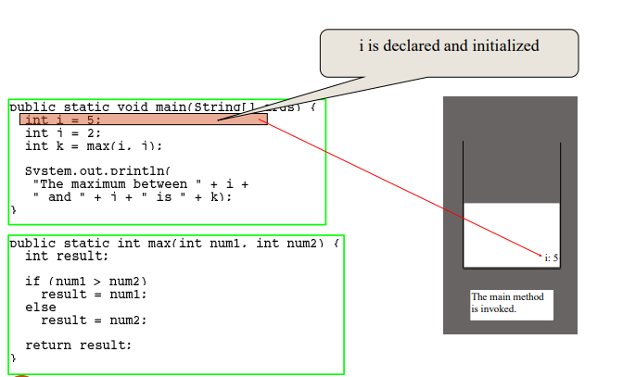
Trace Call Stack
The main method is invoked

Slide 18
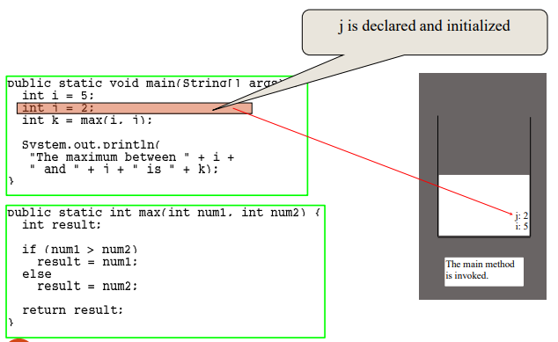
Trace Call Stack

Slide 19
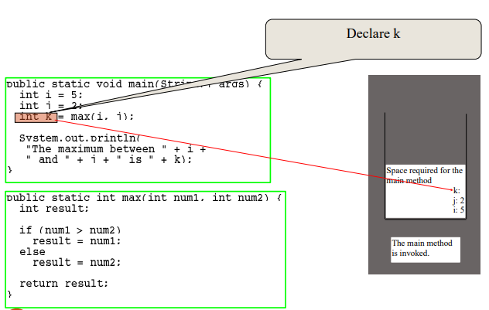
Trace Call Stack

Slide 20
Trace Call Stack

Slide 21
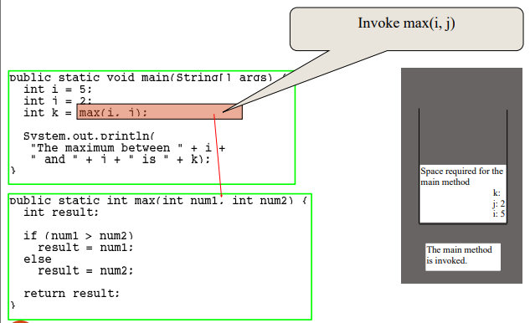
Trace Call Stack

Slide 22
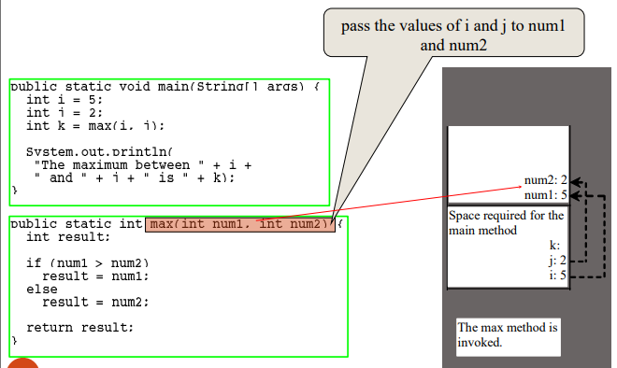
Trace Call Stack
The max method is invoked

Slide 23
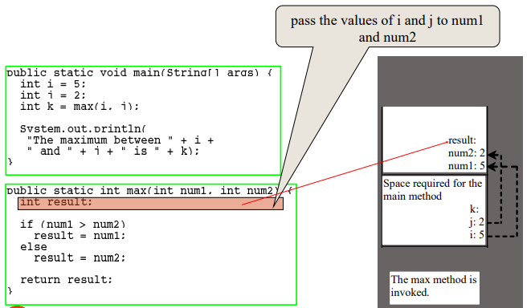
Trace Call Stack

Slide 24
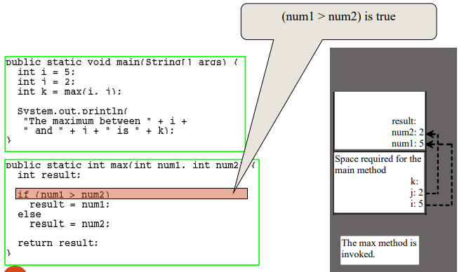
Trace Call Stack

Slide 25
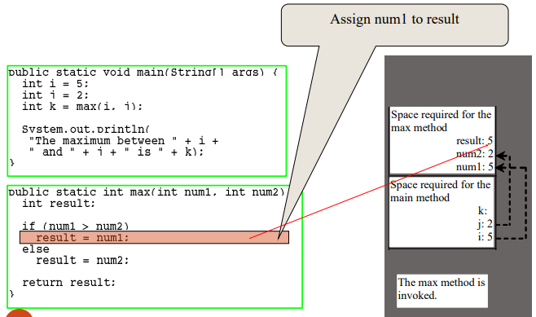
Trace Call Stack

Slide 26
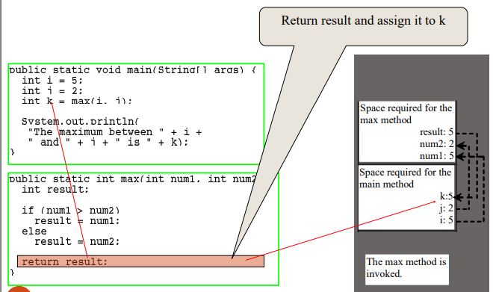
Trace Call Stack
The max method is finished and the return value is sent to k
Max subroutine in stack will be empty

Slide 27
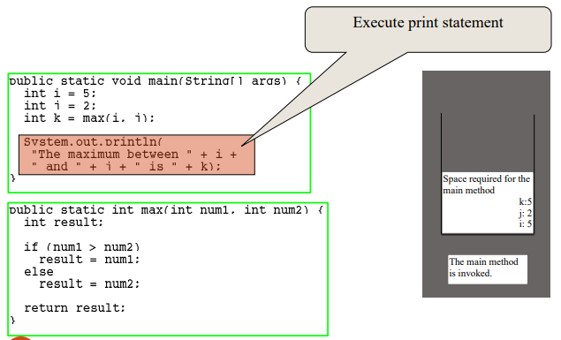
Trace Call Stack

Slide 28
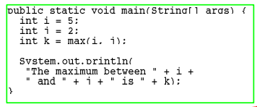
Trace Call Stack
Stack is empty

Slide 29
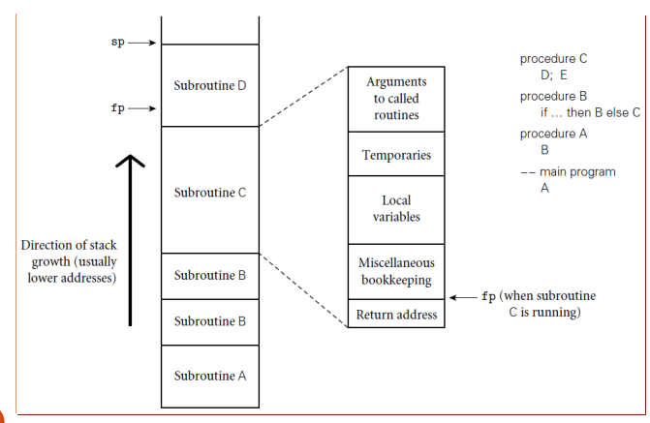
Stack Pointers

Slide 30
Explicit Heap-Dynamic Variables
Variables allocated and deallocated during run-time by the programmer
C++: new/delete operator for pointers
Advantages:
Allows structures like trees and linked list that can grow and shrink during runtime.
Disadvantages:
Pointers can reduce reliability
Adds complexity to the program because of memory management

Slide 31
Implicit Heap-Dynamic Variables
Variables bound to heap storage only when they are assigned values at run-time
JavaScript: highs [74, 84, 86, 90, 71];
Space reallocated every time a variable is assigned
Advantage:
Very flexible
Disadvantages:
Slower run-time because of memory management
Loss of some error detection from the compiler

Slide 32
Variables, Revisited
Names (Discussed)
Addresses (Discussed)
Values (Discussed)
Types (Discussed, but deeper dive next week)
Lifetimes (Discussed)
Scope (Next week)

